Slide 1
Linear Optimization
The Punch Line

Slide 2
A lite review?
How can we write a line?

Slide 3
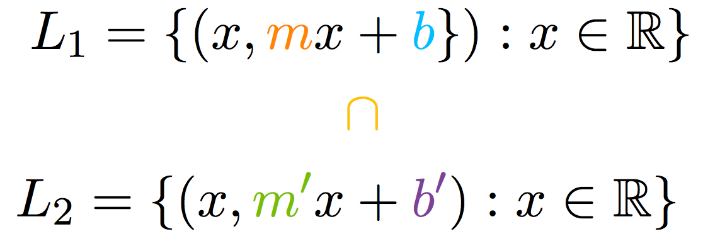
A lite review?
How do we solve for intersections of lines?

Slide 4
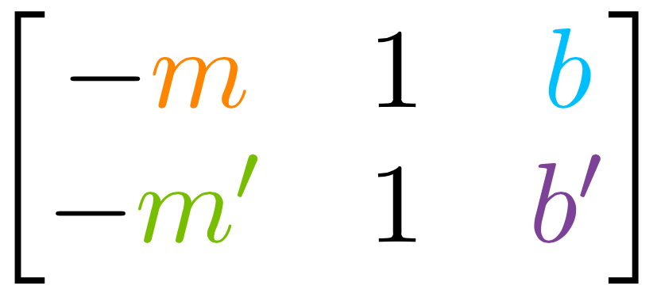
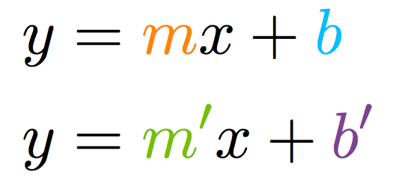
Matrices:

Slide 5
Matrices: (lets see one)

Slide 6
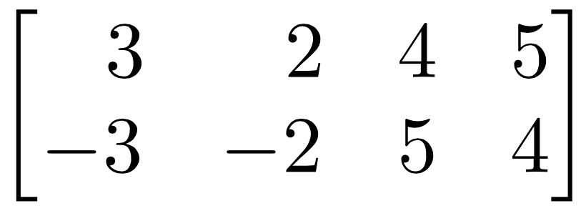
Matrices: (lets see one)

Slide 7
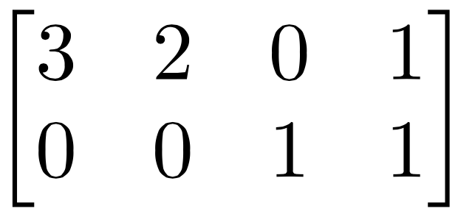
Matrices: (lets see one)

Slide 8
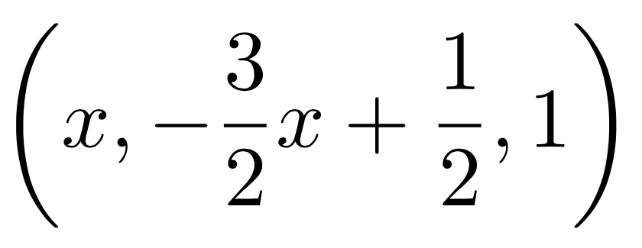
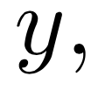
Matrices: (lets see one)
z=1 and 3x+2y=1

Slide 9
Back to our regularly scheduled programming...
Hold back your excitement!

Slide 10
What’s Linear Optimization?

Slide 11
MAX Problem

Slide 12
constraints!
constraints!

Slide 13
How can we solve this?
The Contour Method!
(first method)

Slide 14
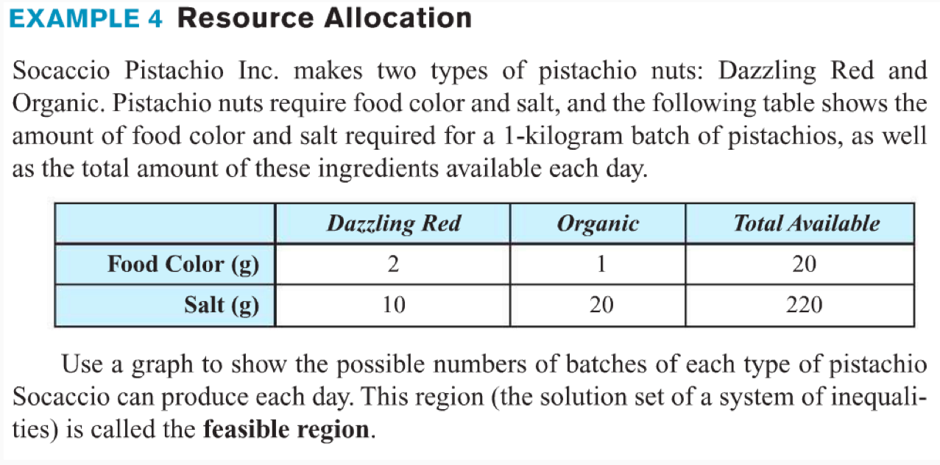
Also, the owner loves the Dazzling red so you must make at least 1 batch of Dazzling red a day. Now if they sell each batch of Dazzling red for $200, and each batch of Organic for $250. Assume we sell all of our batches made each day, how much of each batch should we make to maximize our profit?

Slide 15
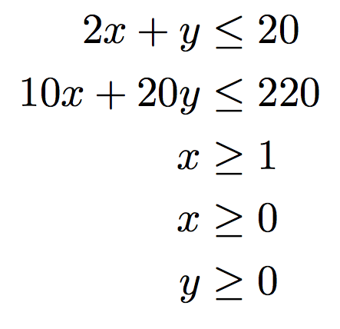
Decision Variables:
Constraints:
(food coloring)
MAX:
(salt)
(client request)
(no negative batches)
(no negative batches)

Slide 16
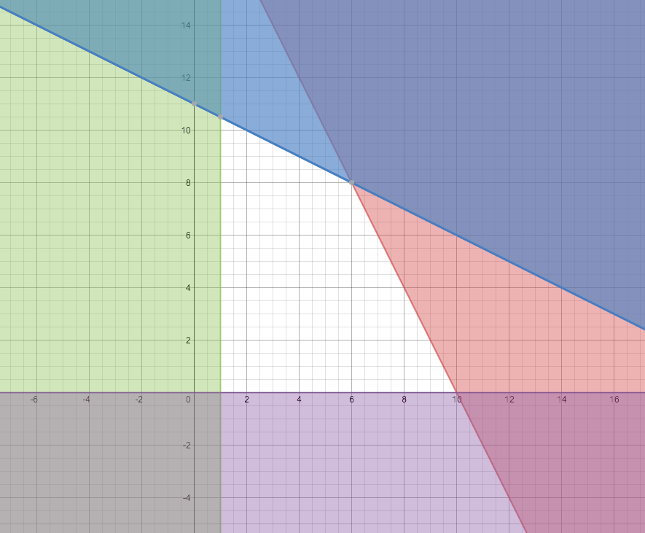
Feasible Region
But nothing is here is for the profit…
What can we do?

Slide 17
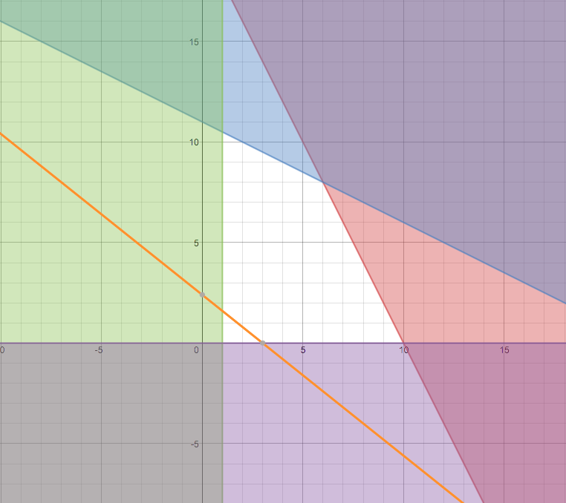
600
Shadows in 2-D world!

Slide 18
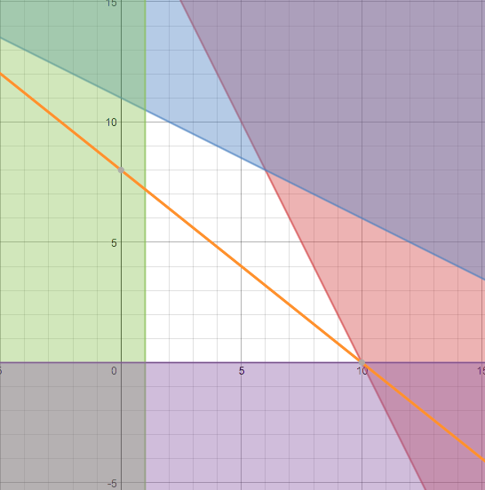
2000

Slide 19
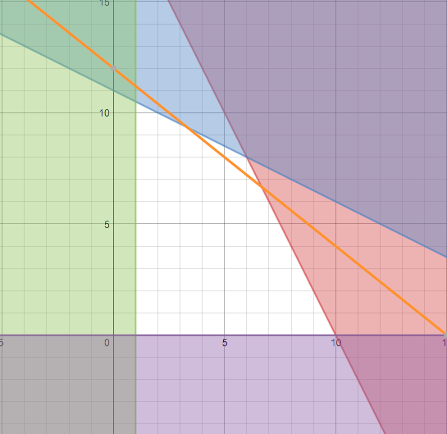
3000

Slide 20
600
2000
3000

Slide 21
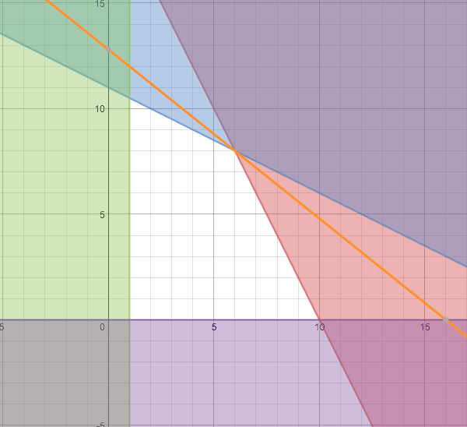
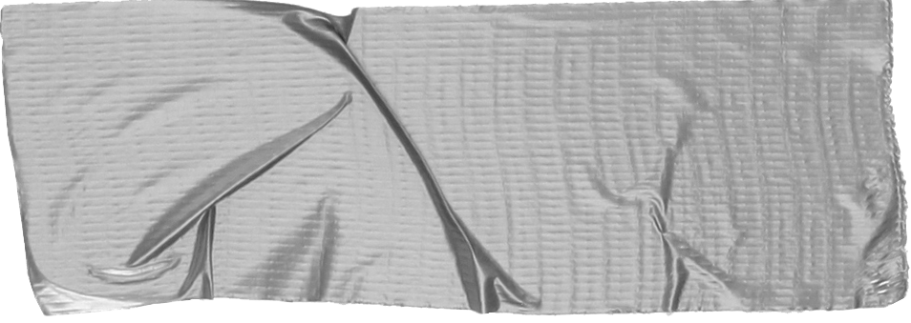
3200
TRUTHS:
A Max or Min will always happen at a corner point!
No really Always!

Slide 22
What if I can’t draw it?
3-D, 4-D, 5-D,...

Slide 23
Lets meet
The Simplex Method!
(second Method)

Slide 24
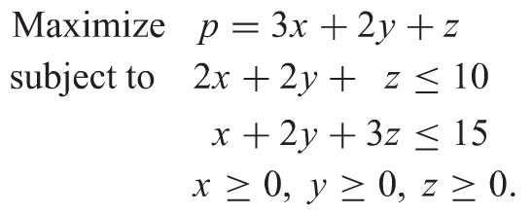
constraints!
What’s the easiest way to “bounce” around “corner points”?

Slide 25
Have we seen before a list of equations which we could always get an answer to? Yes, but they were all equalities!

Slide 26
Can we interpret this as all equalities?

Slide 27
Yes! (But we have to be really clever!)
Fun Fact:
When the simplex method was invented, people didn’t accept it, one mathematician actually spent the rest of his life proving that there is an example where this isn’t the best way to solve.

Slide 30
NOTE: never change the sign of P!

Slide 32
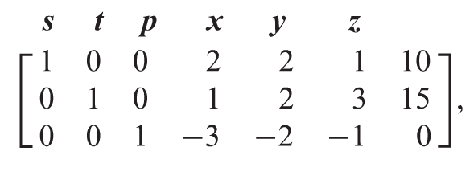
What we have!

Slide 33
What we want!

Slide 34
What we have!

Slide 35
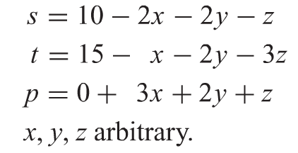
Can be anything!
So where do we start? How about the easiest x=0, y=0 and z=0!

Slide 36
What’s going on:
We are going to bounce around the “corner points” so we start at the point (0,0,0)

Slide 37
(They contribute to the “solution” i.e. non-zero, call these ON)
(They don’t contribute to the “solution” i.e. zero, call these OFF)

Slide 38
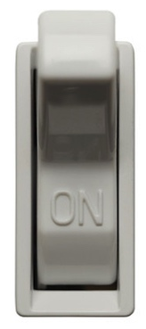

Slide 39
Lets get BIG
This will make P bigger fastest!

Slide 40
How big can I make x before
I break a constraint?
Lets get BIG

Slide 41
How can we keep
track of this?
Lets get BIG

Slide 42
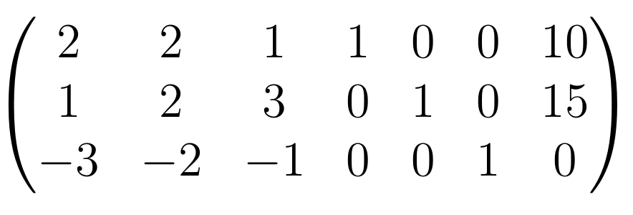
How can we keep
track of this?
Lets get BIG
Keep!
Kill!

Slide 43
How can we keep track of this?
Lets get BIG

Slide 44
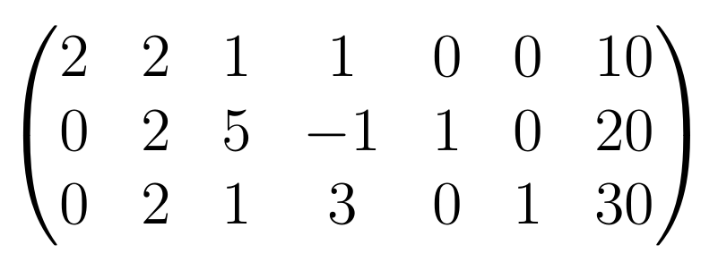
How can we keep track of this?
Lets get BIG

Slide 45
Can I get Any BIGGER?
Lets get BIG

Slide 46
So what is my answer?

